Slide 1
CS60055: Ubiquitous Computing
Contactless Sensing
Part II: WiFi Sensing

Slide 2



WiFi Sensing
WiFi Access Point
WiFi Receiving device
Image Courtesy: Vijay Kumar Singh, IIIT Delhi

Slide 3
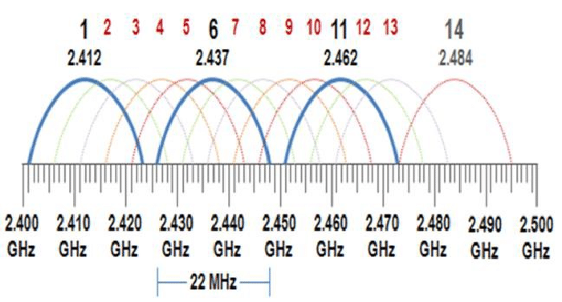
WiFi Channels – 2.4 GHz

Slide 4
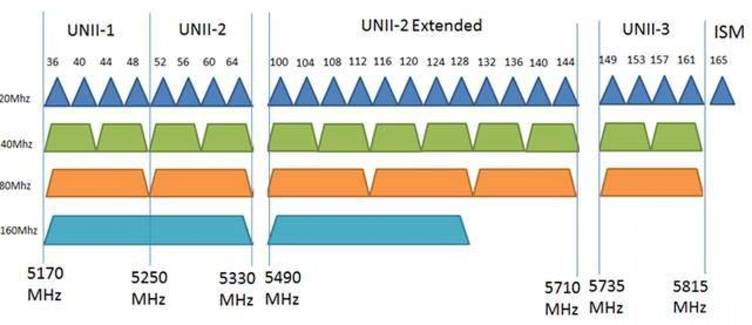
WiFi Channels - 5GHz
140 Channels, 24 non-overlapping

Slide 5
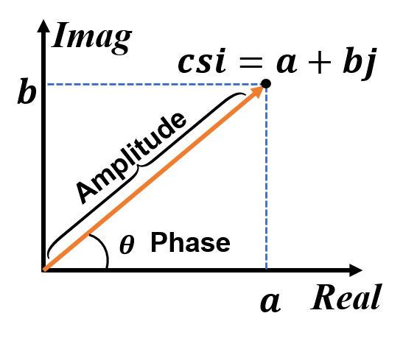
Channel State Information (CSI)
Characterizes how wireless signal propagates from the transmitter to the receiver at certain carrier frequencies
  CSI amplitude and phase are impacted by multipath effects (amplitude attenuation, phase shift)
Represents the coefficient of a WiFi channel
A packet transmitted with M transmitting
antennas, N receiving antennas, 20MHz
channel bandwitdh
  CSI is a complex matrix of size MxNxZ where Z is
  the number of subcarriers in the target bandwidth

Slide 6
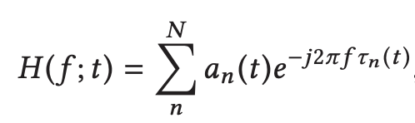
Channel State Information (CSI)
Each CSI entry represents the channel frequency response (CFR):
  a_{i}(t) is the amplitude attenuation factor, τ_{i}(t) is the propagation delay, f is the carrier frequency, N is the total number of reflection path
Wi-Fi NIC use several bits to represent the value of the real and imaginary numbers.
  For example, Atheros Wi-Fi NIC uses 10 bits to give the value of the real and another 10 bits to describe the imaginary part of the number.

Slide 7
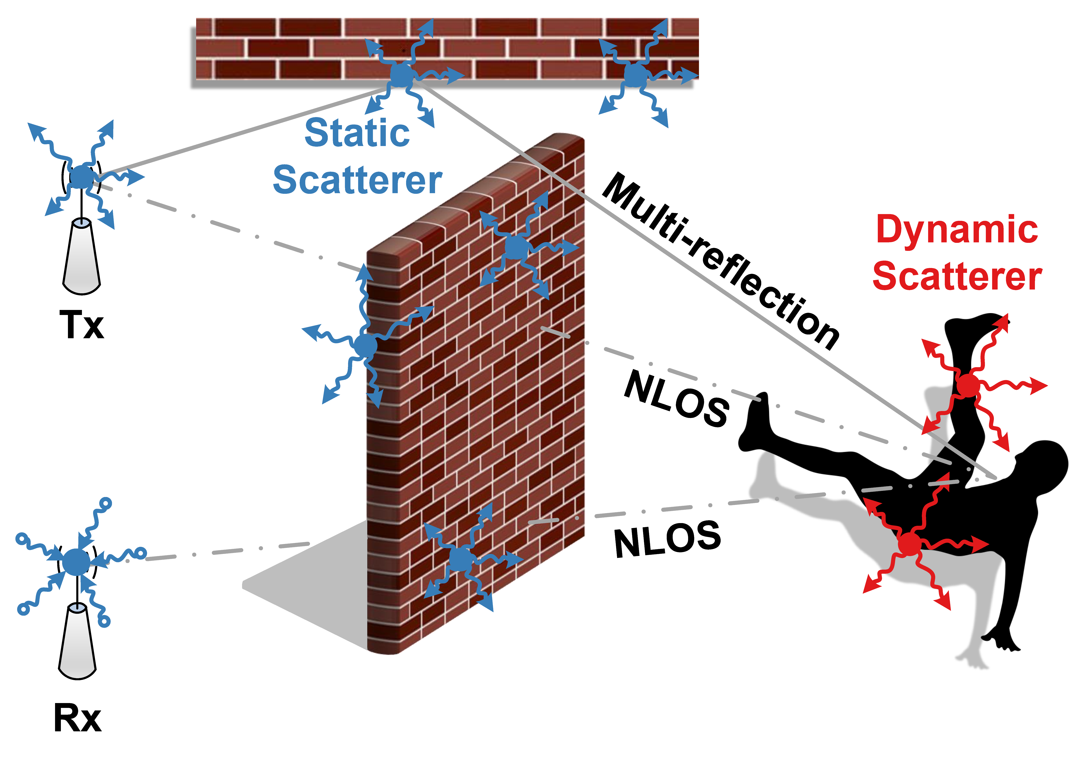
CSI Computation – Scattering Model
Signal can be scattered through both the static and the dynamic objects in the environment
  CSI observed by the receiver is
  added up with the contributions
  from the static and the dynamic
  scatterers
  You may think of each scatterer as
  a virtual TX
  Suitable for indoor scenarios, and
  is impacted by the dynamic
  movements within indoor – suitable
  for sensing movements
Image Source: https://tns.thss.tsinghua.edu.cn/wst/docs/pre/

Slide 8
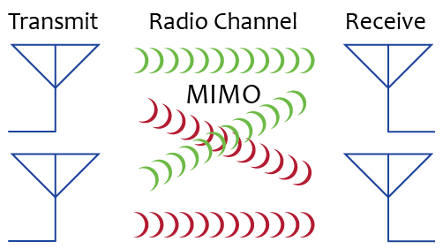
WiFi Channel with MIMO and OFDM
MIMO: Multiple Input Multiple Output
  Use multiple TX and RX for spatial multiplexing
  Can do a better estimation of multipath based
  on Line of Sight (LoS) and Non-line of Sight (nLoS)
  signal analysis
Orthogonal Frequency Division Multiplexing (OFDM)
  Rather than using a wideband, divide the wideband into multiple narrowbands, called the subcarriers
  Helps in reducing attenuation loss and recover from channel errors
  A specialized frequency division multiplexing
    The subcarriers are orthogonal to each other

Slide 9
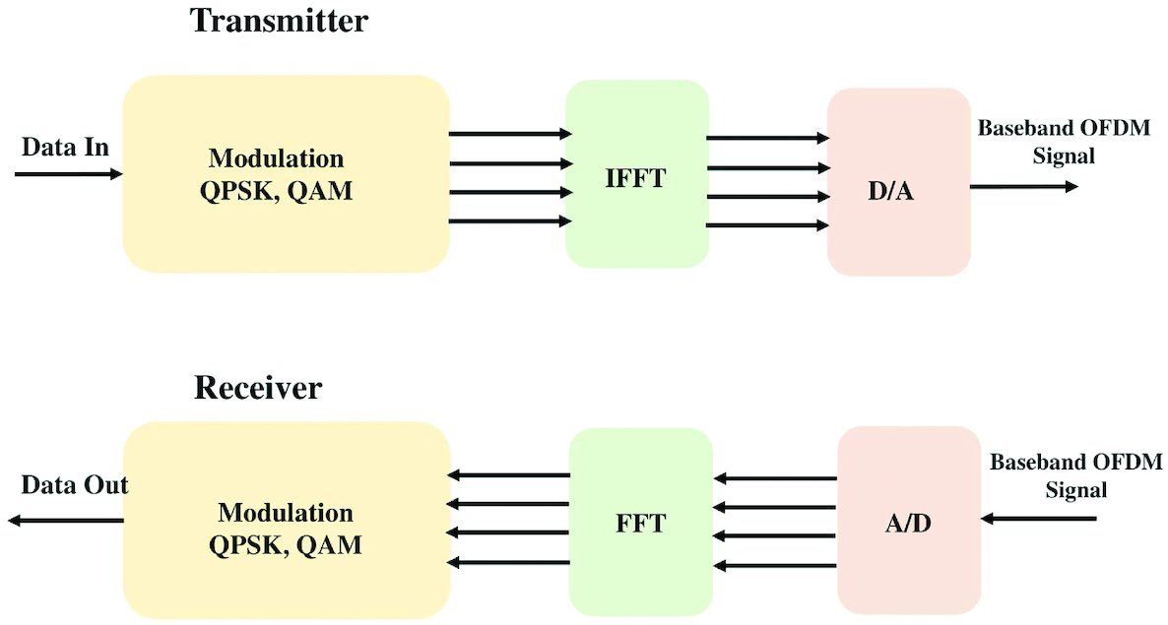
WiFi Tx and Rx
Image Source: https://doi.org/10.1093/jcde/qwaa048

Slide 10
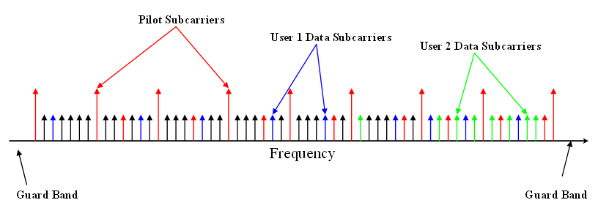
OFDMA in 802.11ax (WiFi 6)
Use the subcarriers to transmit data from multiple users simultaneously

Slide 11
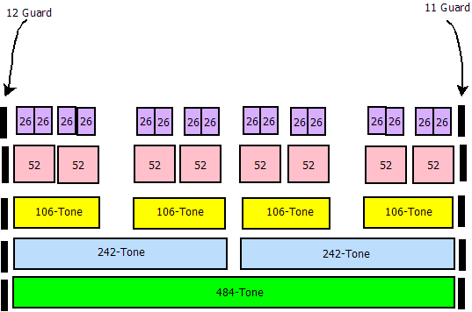
OFDMA in 802.11ax (WiFi 6)
Use the subcarriers to transmit data from multiple users simultaneously
The subcarriers are grouped together to form the resource units (RUs)
  Different RUs can be assigned to different users, thus increasing the spectral efficiency significantly
Three types of subcarriers are used
  Data subcarrier: To transmit the actual data
  Pilot subcarrier: Used for phase information
  and parameter tracking
  Unused: DC, guard band, unallocated
Different types of RUs are supported
based on the bandwidth requirements
RUs for 40 MHz Channel

Slide 12

CSI Measurement for OFDM
WiFi Tx transmits Long Training Symbols (LTFs)
  Contains pre-defined symbols for each subcarrier, in the packet preamble
When LTFs are received, Rx estimates the CSIs using the received signal and the original LTFs
For each subcarrier, the WiFi channel is modeled as,
  y is the received signal
  x is the transmitted signal
  H is the CSI matrix
  n is the noise vector
The estimated CSI is a 3-D matrix of complex values

Slide 13
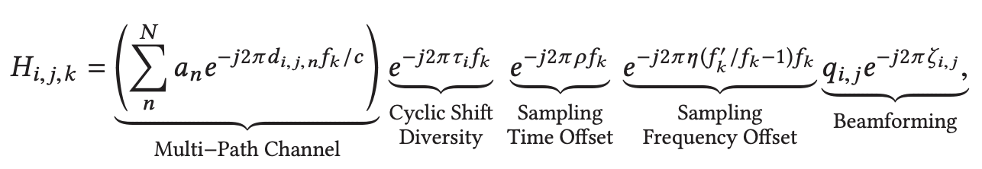
CSI Measurement for OFDM
In real world, the measured CSI is impacted by several factors
  Multi-path channels
  Transmit/receive processing
  Hardware/software errors
The measured baseband-to-baseband CSI can be represented as,
  d_{i,j,n} is the path length from the i^{th} transmit antenna to the j^{th} receive antenna of the n^{th} path
  f_{k} is the carrier frequency, ρ is the sampling time offset, η is the sampling frequency offset, q_{i,j} and ζ_{i,j} are the amplitude attenuation and phase shift of the beamforming

Slide 14
CSI Measurement for OFDM
In real world, the measured CSI is impacted by several factors
  Multi-path channels
  Transmit/receive processing
  Hardware/software errors
The measured baseband-to-baseband CSI can be represented as,
  d_{i,j,n} is the path length from the i^{th} transmit antenna to the j^{th} receive antenna of the n^{th} path
  f_{k} is the carrier frequency, ρ is the sampling time offset, η is the sampling frequency offset, q_{i,j} and ζ_{i,j} are the amplitude attenuation and phase shift of the beamforming
Signal Processing techniques are needed to remove the impact of CSD, STO, SFO, and beamforming

Slide 15
Obtaining CSI
Not all COTS WiFi hardware allows exporting the CSI data; available for few cases --
  802.11 CSI tools (https://dhalperi.github.io/linux-80211n-csitool/): Uses Intel 5300
  Atheros CSI tools (https://wands.sg/research/wifi/AtherosCSI/) - Qualcomm Atheros
  ESP32 CSI toolkit (https://stevenmhernandez.github.io/ESP32-CSI-Tool/) - ESP32
  Intel 5300 and Atheros provide much stable and unnoisy CSI values; however, works for restricted settings (802.11n)
  In contrast, ESP32 is a cheap and easily available device; the data can be little noisy but works well for practical applications with suitable data pre-processing techniques applied

Slide 16
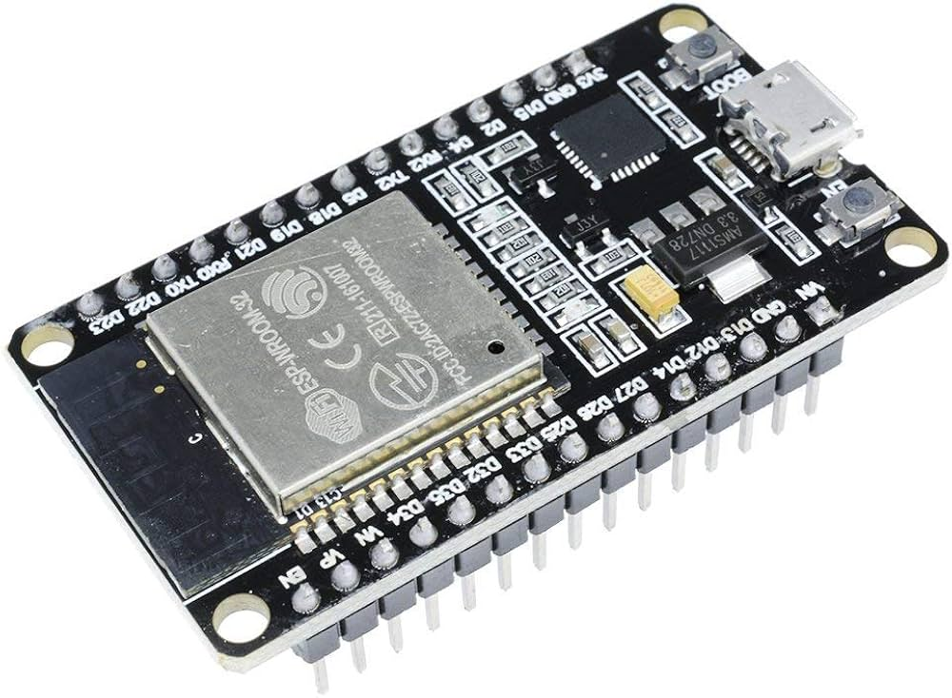
Visualizing CSI (ESP32 as a Use Case)
Supports three CFR types
  Legacy long training field (LLTF): Uses the long training symbol for legacy wifi devices like 802.11a
  High-throughput LTF (HT-LTF): For high-throughput WiFi like 802.11n
  Space-time block code HT-LTF (STBC-HT-LTF): For MIMO settings
You need to configure the CFR types and the mode of operations:
  active_sta: Connect to some AP and send packet requests
  active_ap: Works like an AP where other devices can connect
  passive: Passively listens CSI frames on a given channel

Slide 17
Understanding the CSI Data – 20 MHz Band
The 20 MHz band has 64 subcarriers
  48 subcarriers carry data (known as data subcarriers).
  4 subcarriers are pilot subcarriers (used for synchronization and channel estimation).
  12 subcarriers are either guard bands or unused.
In ESP32, the real and imaginary components of CSI are typically represented as 8-bit signed integers (1 byte each)
ESP32 captures CSI data for all 64 subcarriers, even though not all subcarriers are used for data transmission (some are guard bands and pilots)
  So, you'll see some zeros in the CSI readings

Slide 18
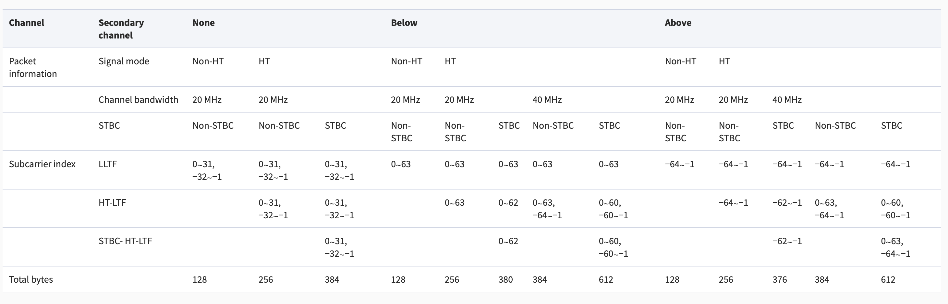
Visualizing CSI (ESP32 as a Use Case)
Each CFR of a subcarrier registers as two bytes of signed characters, the first part being the imaginary, and the second part is the real value
CSI Information from different training fields:

Slide 19
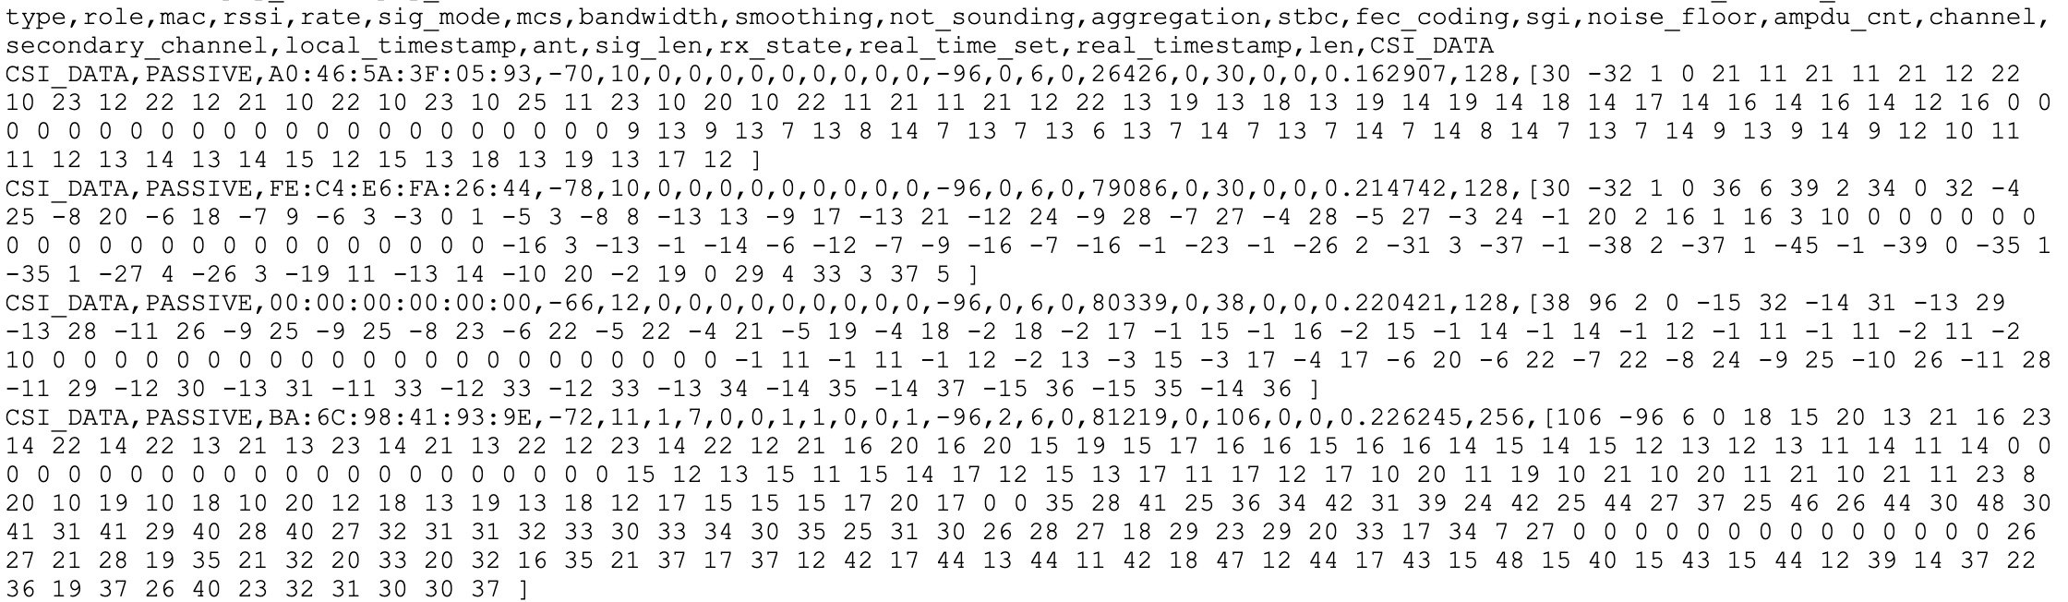
Visualizing CSI (ESP32 as a Use Case)
Reading taken at the CSE Department 2nd Floor (Room CSE-318)
Full data: csi_data
Thanks to Debjit Chatterjee for collecting these data and sharing the sample plots with me

Slide 20
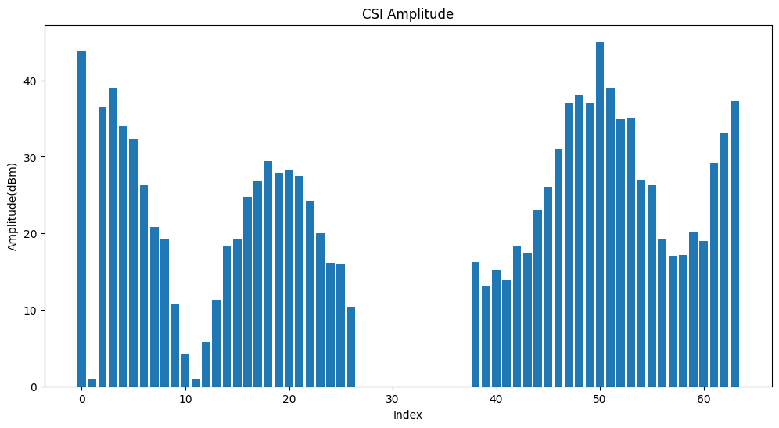
Computing Amplitude and Phase from the CSI Data
Thanks to Debjit Chatterjee for collecting these data and sharing the sample plots with me

Slide 21
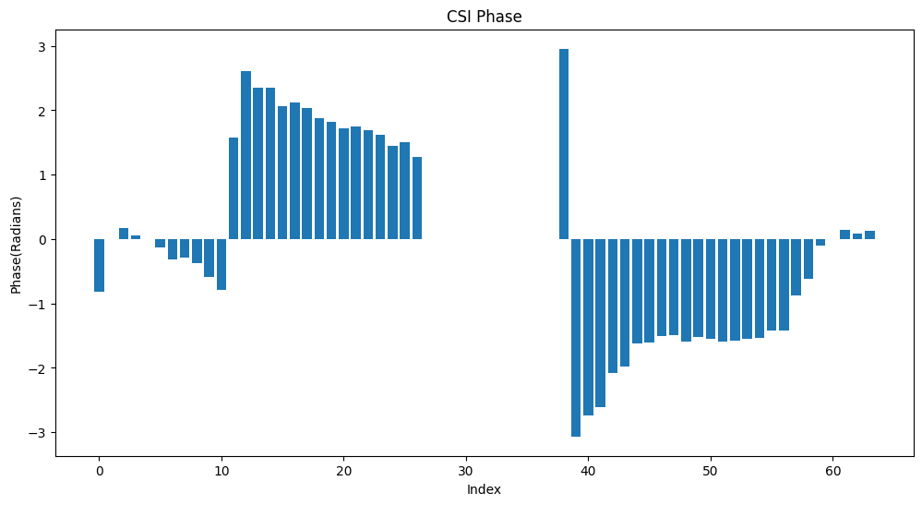
Computing Amplitude and Phase from the CSI Data
Thanks to Debjit Chatterjee for collecting these data and sharing the sample plots with me

Slide 22
Signal Processing on the CSI Data
Phase Offset Removal
  Raw CSI measurements contain phase offsets due to hardware and software errors
  Example: Sampling Time/Frequency Offset (STO/SFO) due to unsynchronized sampling of clocks/frequencies at the receiver and the transmitter
  Assuming that the phase offset will be same across packets and subcarriers, use CSI phase difference of the adjacent subcarriers to average out the phase offset
    not accurate but useful for many sensing applications that are not impacted much by phase offsets (when you just need the pattern, say for activity recognition)
  Phase offset introduces estimation error for AoA and ToF computation – need accurate values for localize and tracking applications
    Uses sophisticated approach like linear regression to estimate the phase offset

Slide 23
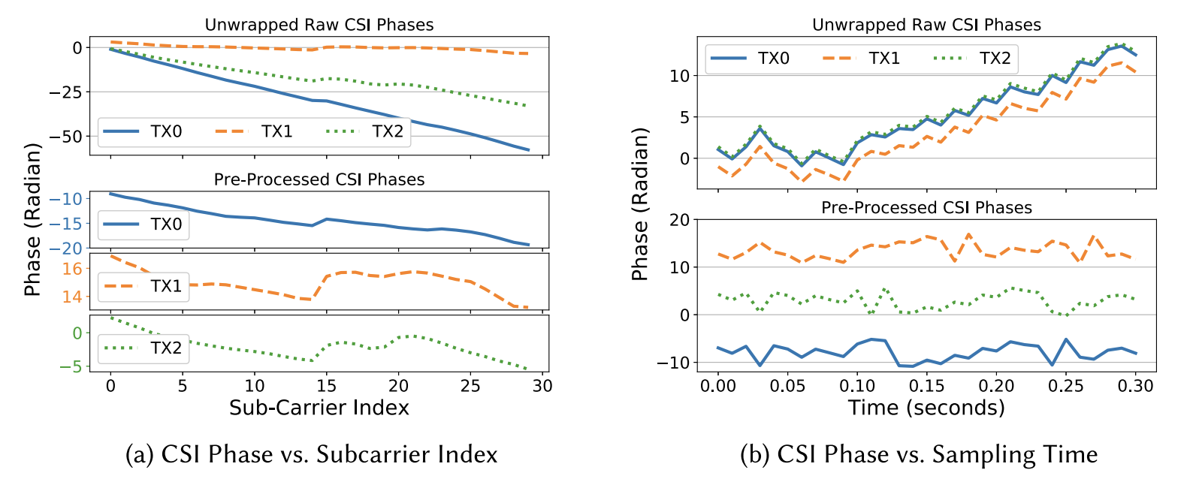
Impact of CSI Phase Offset
Source: https://dl.acm.org/doi/pdf/10.1145/3310194

Slide 24
Signal Processing on the CSI Data
Outliers Removal
  Noises from the environment (particularly, high frequency noises) result outliers in the data – may affect the patterns
  Low pass filters (LPF), Hampel filters, wavelet filters are typically used
Hardware/beamforming noise
  Methods like signal nulling are used to avoid beamforming noises
  Cancels out the side-beams apart from the main beam

Slide 25
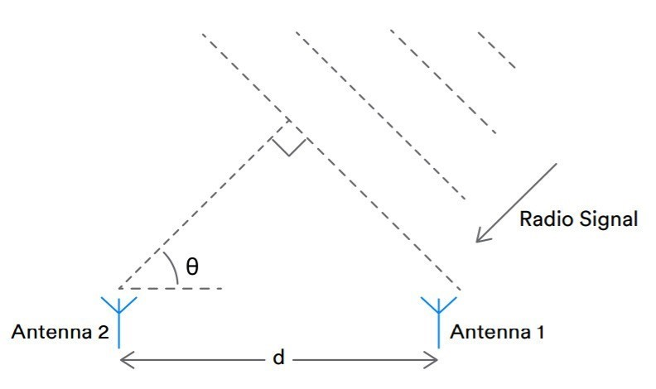
Angle of Arrival (AoA) Estimation
Estimate the direction from which the signal arrives at a receiver from the transmitter
  Used widely in indoor localization

Slide 26
Angle of Arrival (AoA) Estimation
Estimate the direction from which the signal arrives at a receiver from the transmitter
  Used widely in indoor localization
MUSIC (Multiple Signal Classification)
  A popular method for AoA estimation
  Used widely for computing AoA from CSI

Slide 27
Multiple Signal Classification (MUSIC)
Leverages the structure of the received signal at an antenna array
  Separates the signal subspace (where the actual signal lies) from the noise subspace
  Estimates AoA by finding directions that corresponds to the smallest projection onto the noise subspace
Signal subspace: Components of the received data that are directly influenced by the incoming signal
Noise subspace: Portion of the data that corresponds to noise and interference (noise is typically weaker and uncorrelated across the antennas)
The noise subspace is orthogonal to the signal subspace – key property used in the MUSIC algorithm
  The signal should be sufficiently different from the noise to help the receiver to separate the signal from the noise
Disclaimer: ChatGPT 4o has been used to generate some explanations of the MUSIC algorithm

Slide 28
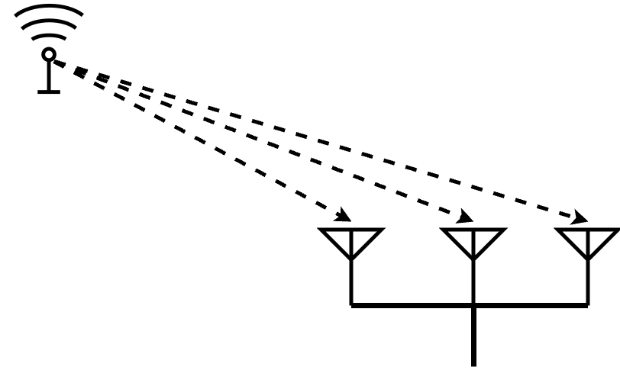
Multiple Signal Classification (MUSIC)
Let H be the input CSI matrix; the MUSIC algorithm works as follows.
Covariance Matrix Calculation
  MUSIC first computes the covariance matrix R=HH^{H}, where H^{H} is the Hermitian transpose (complex conjugate transpose) of the CSI matrix H
  Captures the spatial correlation between the signal received at different antennas
Note that whenever a signal comes from a specific direction, it reaches the antennas with phase shifts and attenuation based on the geometry of the antenna array

Slide 29
Multiple Signal Classification (MUSIC)
Let H be the input CSI matrix; the MUSIC algorithm works as follows.
Covariance Matrix Calculation
  MUSIC first computes the covariance matrix R=HH^{H}, where H^{H} is the Hermitian transpose (complex conjugate transpose) of the CSI matrix H
  Captures the spatial correlation between the signal received at different antennas
Note that whenever a signal comes from a specific direction, it reaches the antennas with phase shifts and attenuation based on the geometry of the antenna array
Leads to predictable variance of signals across antennas

Slide 30
Multiple Signal Classification (MUSIC)
Let H be the input CSI matrix; the MUSIC algorithm works as follows.
Covariance Matrix Calculation
  MUSIC first computes the covariance matrix R=HH^{H}, where H^{H} is the Hermitian transpose (complex conjugate transpose) of the CSI matrix H
  Captures the spatial correlation between the signal received at different antennas
In practice, the covariance matrix is computed as R=E[HH^{H}], where E[.] is the expectation operator that computes the average over multiple measurements

Slide 31
Multiple Signal Classification (MUSIC)
Let H be the input CSI matrix; the MUSIC algorithm works as follows.
Covariance Matrix Calculation
  MUSIC first computes the covariance matrix R=HH^{H}, where H^{H} is the Hermitian transpose (complex conjugate transpose) of the CSI matrix H
  Captures the spatial correlation between the signal received at different antennas
In practice, the covariance matrix is computed as R=E[HH^{H}], where E[.] is the expectation operator that computes the average over multiple measurements
Notably, Signals coming from the same source (or direction) will induce similar patterns of phase shifts and amplitudes across the antennas
  These similarities show up as correlations between the signals received at different antennas.

Slide 32
Multiple Signal Classification (MUSIC)
Eigenvalue Decomposition
  The covariance matrix R is decomposed into eigenvalue and eigenvectors:
  R=EΛE^{H}
  E is the matrix of eigenvectors
  Λ is the diagonal matrix of eigenvalues, sorted in descending order
Av=λv
A is the matrix, v is the eigenvector, and λ is the eigenvalue
Note: Eigenvectors are often viewed as the "principal axes" of transformation. When a matrix is applied to a space (like scaling, stretching, or rotating vectors), the eigenvectors are the directions along which these transformations occur without altering direction.

Slide 33
What Eigenvectors Represent in MUSIC
The eigenvectors of the covariance matrix represent the principal directions in the signal space where the energy or correlation of the received signals is strongest.
Signal Subspace: The eigenvectors corresponding to the largest eigenvalues span the signal subspace.
  These eigenvectors represent the directions of arrival (AoA) of the incoming signals because they capture the dominant signal components in the received data.
Noise Subspace: The eigenvectors corresponding to the smallest eigenvalues span the noise subspace.
  These eigenvectors capture the directions that are primarily noise, where no significant signal energy is present.

Slide 34
What Eigenvalues Represent in MUSIC
The eigenvalues represent the strength or power of the signal components along the corresponding eigenvector directions.
Large eigenvalues correspond to directions where the signal energy is concentrated
  The directions from which the actual signal is arriving (the signal subspace).
Small eigenvalues correspond to noise
  Note that the noise power is typically much smaller than the signal power (the noise subspace).

Slide 35
Orthonormal Basis of Eigenvectors
The eigenvectors form an orthonormal basis, which means they are mutually orthogonal
  a property of eigenvalue decomposition when dealing with Hermitian (or symmetric) matrices like the covariance matrix R
Therefore,
  Eigenvectors associated with different eigenvalues are orthogonal to each other
  The signal and noise subspaces correspond to different sets of eigenvectors, so they are orthogonal by construction

Slide 36
Interpretation of Orthogonality
Orthogonality between the signal and noise subspaces
  A vector in the signal subspace (e.g., the steering vector for the actual signal's AoA) will have no component in the noise subspace
Conversely, the steering vectors for angles that do not correspond to an actual signal AoA will have non-zero projections onto the noise subspace

Slide 37
Exploiting Orthogonality in MUSIC
The MUSIC algorithm uses this orthogonality property to estimate the AoA.
  For a hypothesized angle θ, a steering vector a(θ) is projected onto the noise subspace.
If the projection of a(θ) onto the noise subspace is small
  the steering vector is nearly orthogonal to the noise subspace
  that angle is likely the true AoA, since the steering vector lies in the signal subspace
If the projection is large, the hypothesized angle does not correspond to an actual signal direction.

Slide 38
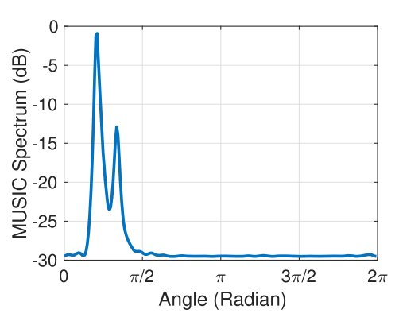
AoA Estimation by MUSIC
The Core Idea: The signal components dominate certain directions (eigenvectors), and noise is uncorrelated and spreads across others.

Slide 39
Estimating Time of Flight (ToF)
ToF is the time it takes for a signal to travel from the transmitter to the receiver
The Power-Delay Profile (PDP) is computed from the CSI, which is used in ToF estimation
  PDP helps to estimate the delay of signals as they travel through different paths between the transmitter and receiver

Slide 40
Power-Delay Profile (PDP)
A representation of the power of a signal as a function of time delay
  Shows how much signal power arrives at the receiver at different delays, which correspond to different propagation paths (e.g., the direct path and various reflected paths)
  Maps the distribution of signal energy over time

Slide 41
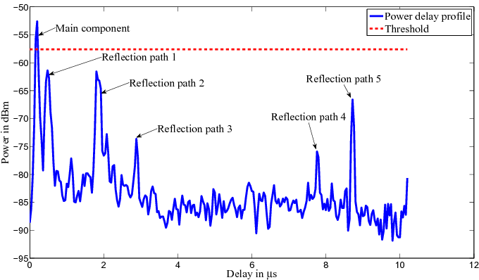
Power-Delay Profile (PDP)
For a multipath environment, a transmitted signal takes multiple paths to reach the receiver
  Each path will introduce a different delay due to varying distances
  PDP captures these delays by showing which parts of the signal energy arrive at the receiver at what times

Slide 42
Computing PDP from CSI
Note that, CSI data provides the channel frequency response H(f) for each subcarrier f
We first apply an Inverse Discrete Fourier Transform (IDFT) to the CSI data
h(t) = IDFT(H(f))
  Transforms the CSI data from the frequency domain to the time domain (or delay domain
  Result is a time-domain representation of the channel, called as the channel impulse response (CIR).

Slide 43
Power Calculation
PDP is obtained by squaring the magnitude of the channel impulse response
PDP(t) = |h(t)|²
  Gives the power of the received signal as a function of time delay.
Peaks in the PDP indicate the presence
of significant signal paths, corresponding
to different propagation delays.

Slide 44
Using PDP for ToF Estimation
ToF can be estimated from the PDP by identifying the time delay of the first significant peak, which usually corresponds to the direct path between the transmitter and receiver

Slide 45
Using PDP for ToF Estimation
ToF can be estimated from the PDP by identifying the time delay of the first significant peak, which usually corresponds to the direct path between the transmitter and receiver
In a multipath environment, the signal can travel directly from the transmitter to the receiver (the line-of-sight path) or via reflections off walls, objects, etc.
  The ToF corresponding to the direct path (the first peak in the PDP) is the shortest delay.
Other peaks in the PDP represent signal paths that include reflections or scatterings, which take longer to reach the receiver.

Slide 46
Using PDP for ToF Estimation
Once the ToF is estimated from the first peak in the PDP, the distance between the transmitter and receiver can be computed using the speed of light c:
d = ToF × c
Note, low SNR can make it harder to detect the first peak in the PDP
  Need sophisticated algorithm for peak detection

Slide 47
Using PDP for ToF Estimation
Once the ToF is estimated from the first peak in the PDP, the distance between the transmitter and receiver can be computed using the speed of light c:
d = ToF × c
Note, low SNR can make it harder to detect the first peak in the PDP
  Need sophisticated algorithm for peak detection
We shall next see how CSI can be used for developing interesting WiFi sensing applications

Slide 48
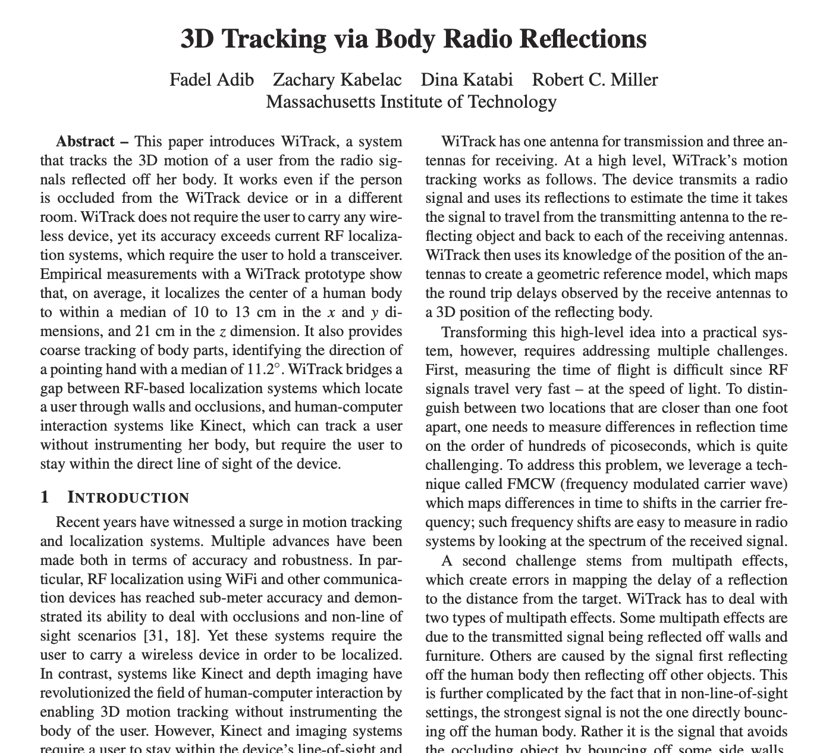

WiTrack: Motion Tracking via Radio Reflections off the Body
NSDI 2024
Slides are based on the presentation by the original authors, available in the above link

Slide 49
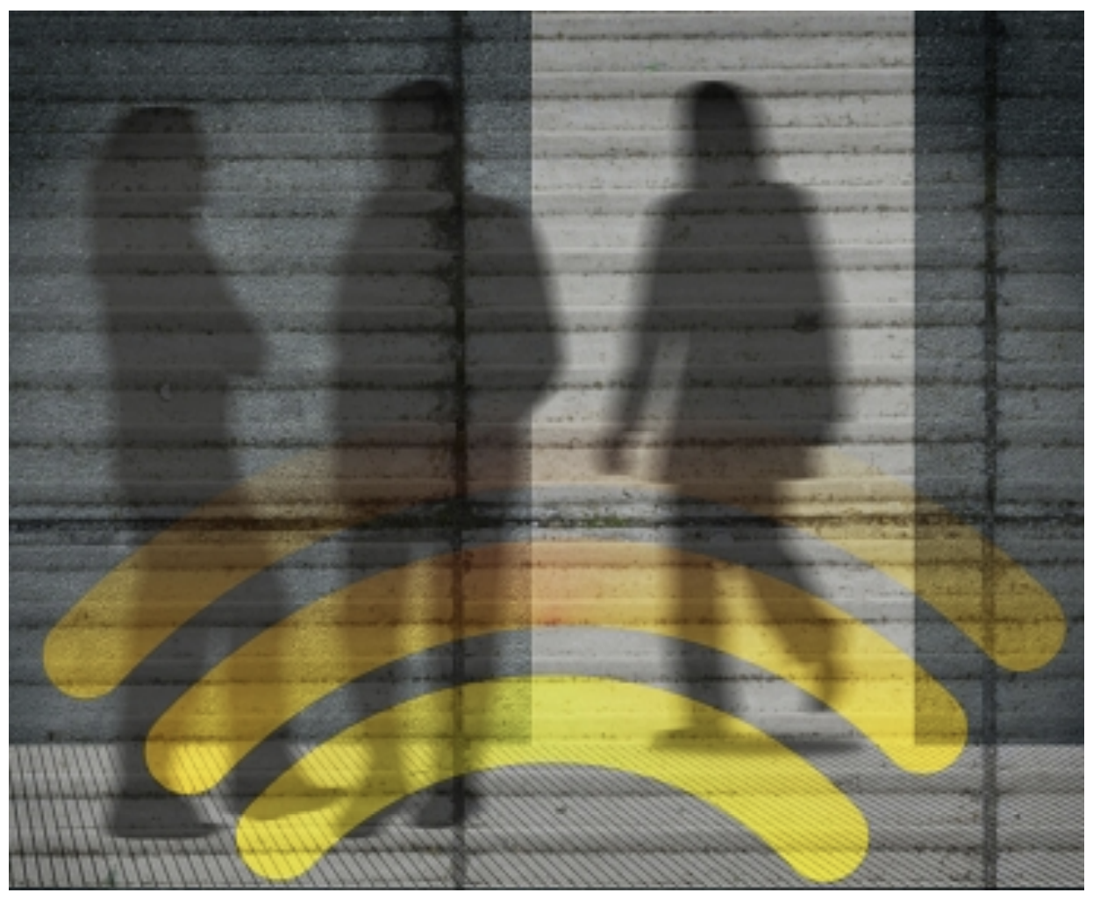
Can We See through Walls with Wireless Signals?
Tracks the 3D motion of a user using radio reflections that bounce off her body
Works through walls and occlusions, but does not require the user to carry any wireless device
The user lift her hand and point at objects in the environment; the device detects the direction of the hand motion, enabling the user to identify objects of interest

Slide 50
WiTrack: The Core Idea
Use a transmitter and a receiver to estimate the signal reflection time from the body
  Actually uses THREE Rx antennas – why, we'll see later!
Measures the time it takes for its signal to travel from the transmit antenna to the reflecting body, and then back to each of the receive antennas – this time is called the Time of Flight (TOF).
Once it obtains the TOF as perceived from each of its receiving antennas, WiTrack leverages the geometric placement of its antennas to localize the moving body in 3D

Slide 51
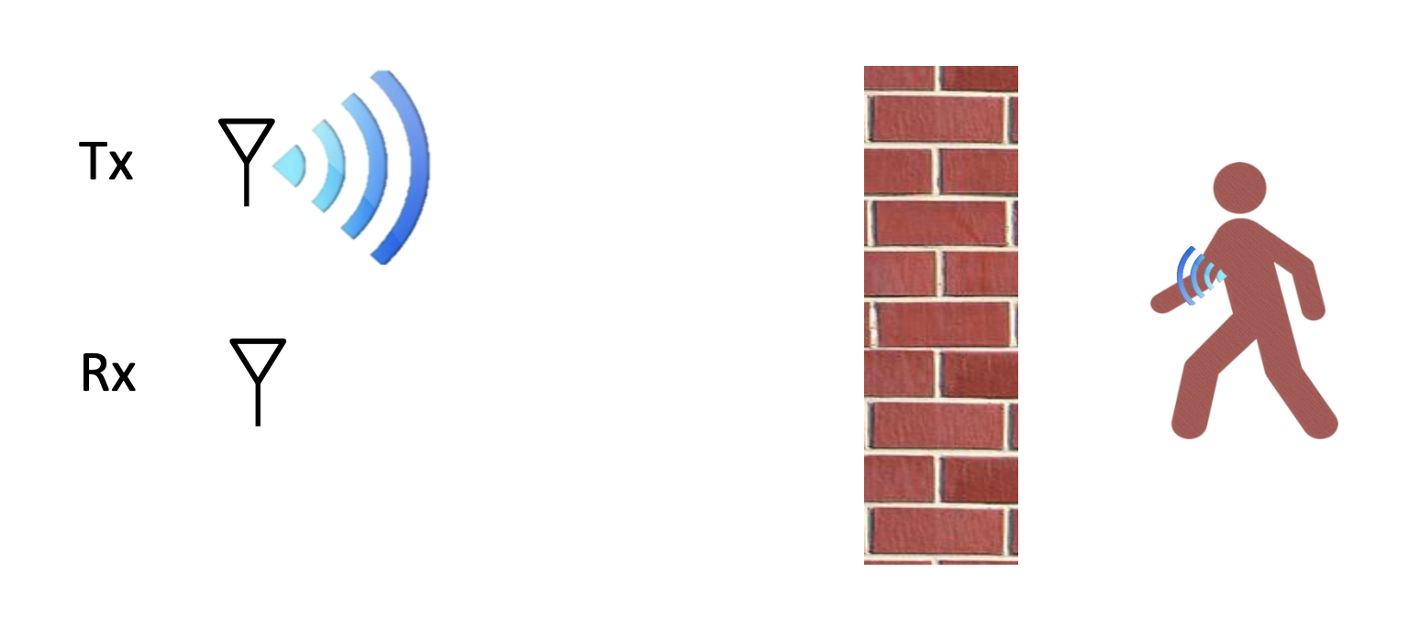
Measuring Distances
Distance = Reflection Time x Speed of Light

Slide 52
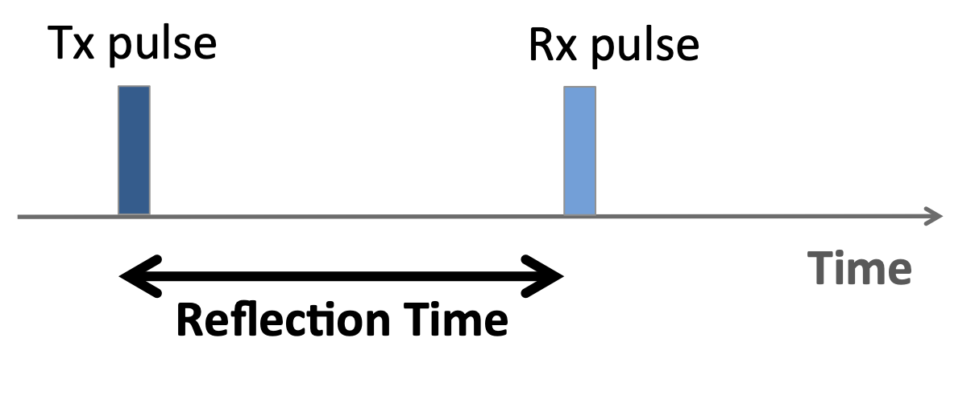
How Do We Measure the Reflection Time?
Option 1: Transmit short pulses and then listen for an echo

Slide 53
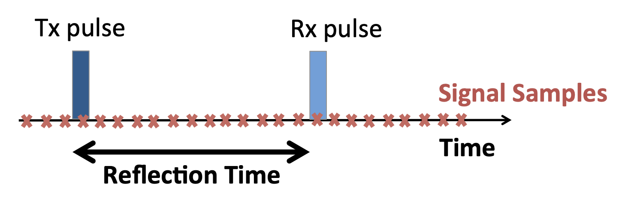
How Do We Measure the Reflection Time?
Option 1: Transmit short pulses and then listen for an echo
Capturing the pulses need sub-nanosecond sampling !
Multi-GHz samplers are expensive and have high noise

Slide 54
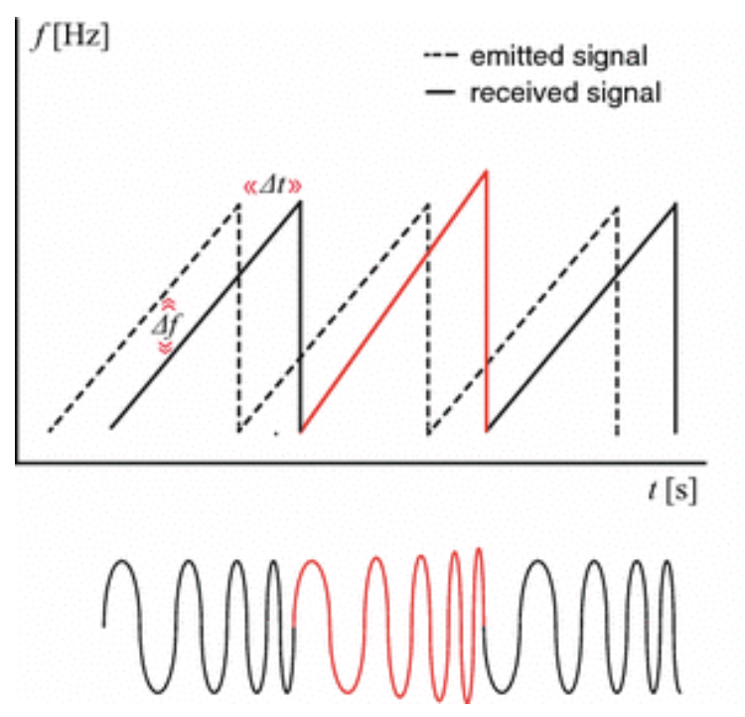
How Do We Measure the Reflection Time?
Option 2: Use frequency modulated continuous wave (FMCW) signals
  Transmits a narrowband signal (e.g., a few KHz) whose carrier frequency changes linearly with time
  Used widely in radars (we'll see many usage later on)
To identify the distance from a reflector, FMWC
compares the carrier frequency of the reflected
signal to that of the transmitted signal
  Since the carrier frequency is changing linearly in time,
  delays in the reflected signals translate into frequency
  shifts in comparison to the transmitted wave

Slide 55
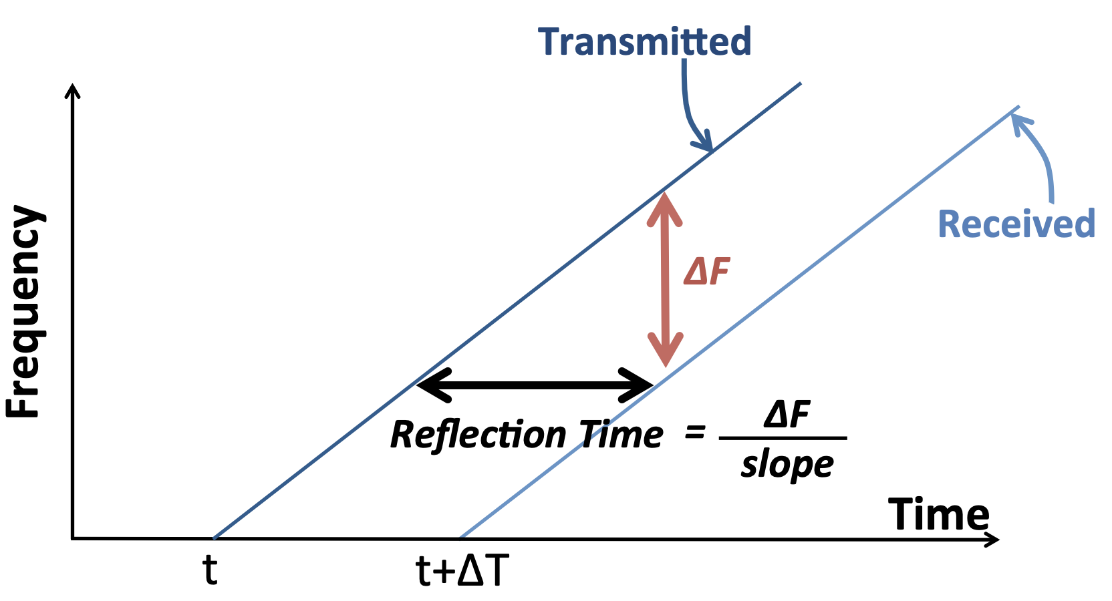
How Do We Measure the Reflection Time?
Option 2: Use frequency modulated continuous wave (FMCW) signals

Slide 56
How Do We Measure the Reflection Time?
Option 2: Use frequency modulated continuous wave (FMCW) signals
How do we measure ΔF?

Slide 57
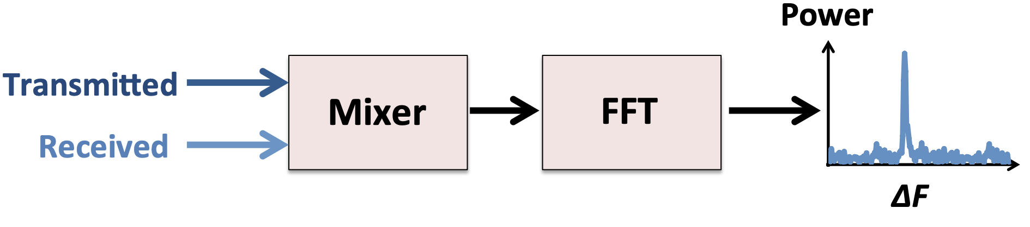
Measuring ΔF
Subtracting frequencies is easy
  For example, removing carrier in WiFi
  Can be done using a mixer (low-power and cheap)
We can compute the TOF from ΔF, and then use it to compute the distance

Slide 58
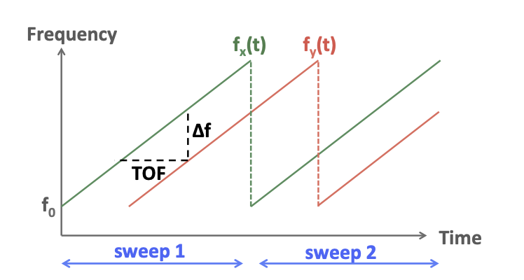
Implementing FMCW for WiTrack
In practice, use multiple sweeps
over time
The resolution of an FMCW system
is a function of the total bandwidth
that the carrier frequency sweeps
  Ability to distinguish between two
  nearby locations, which depends on
  the ability to distinguish their TOFs,
  which itself depends on the resolution
  in distinguishing frequency shifts Δf
The FFT is typically taken over a duration of one sweep of the carrier frequency

Slide 59
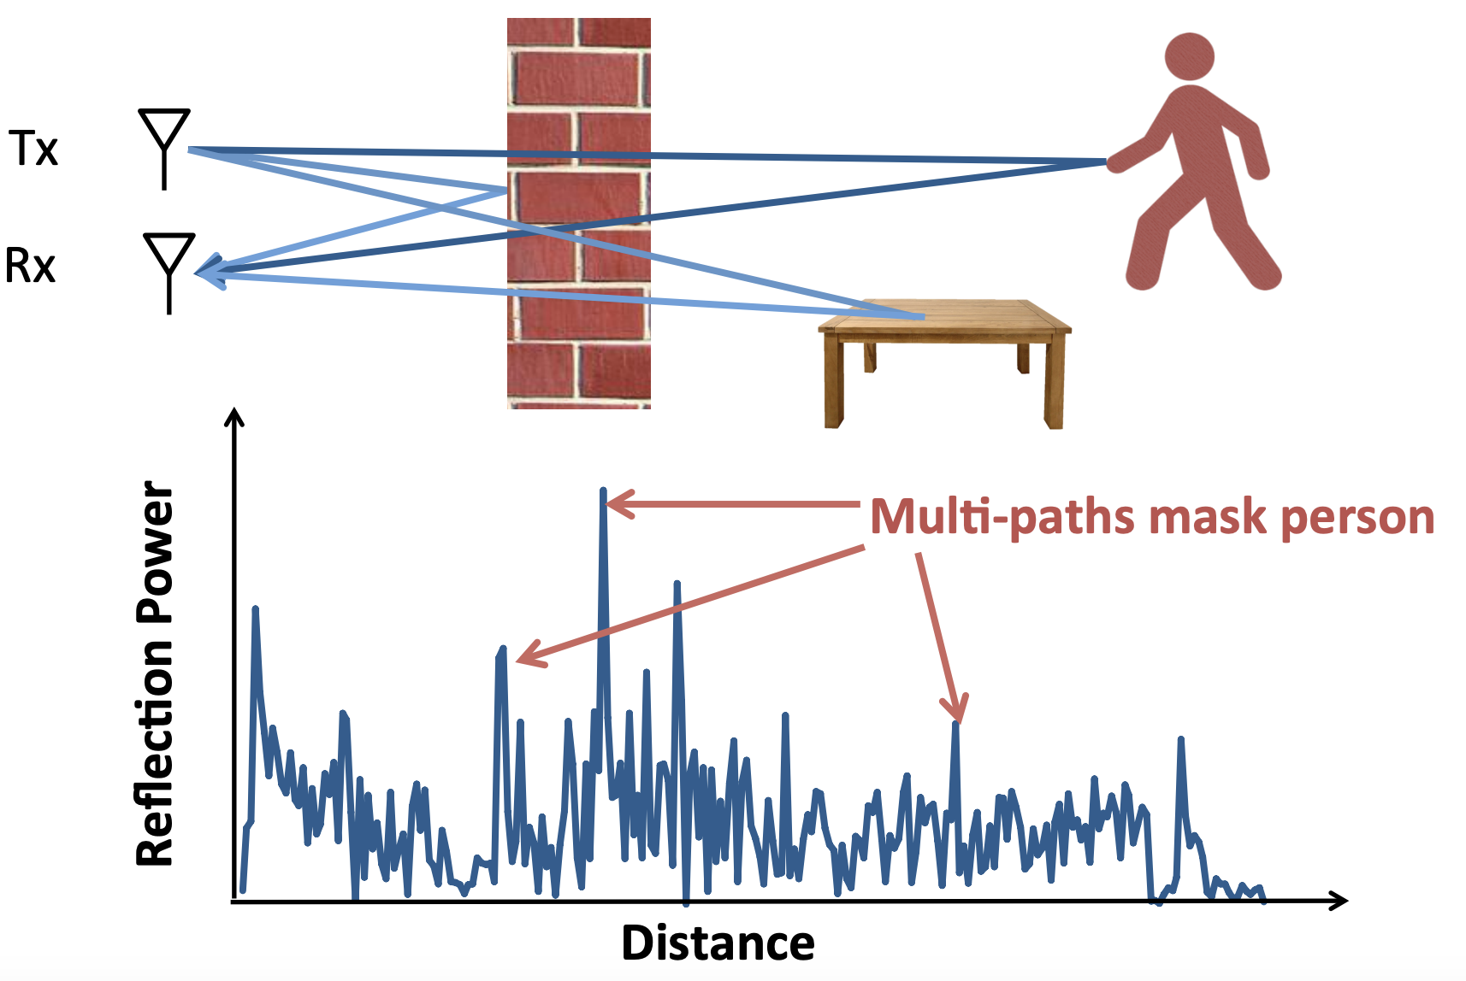
Challange
Multipath introduces many reflections

Slide 60
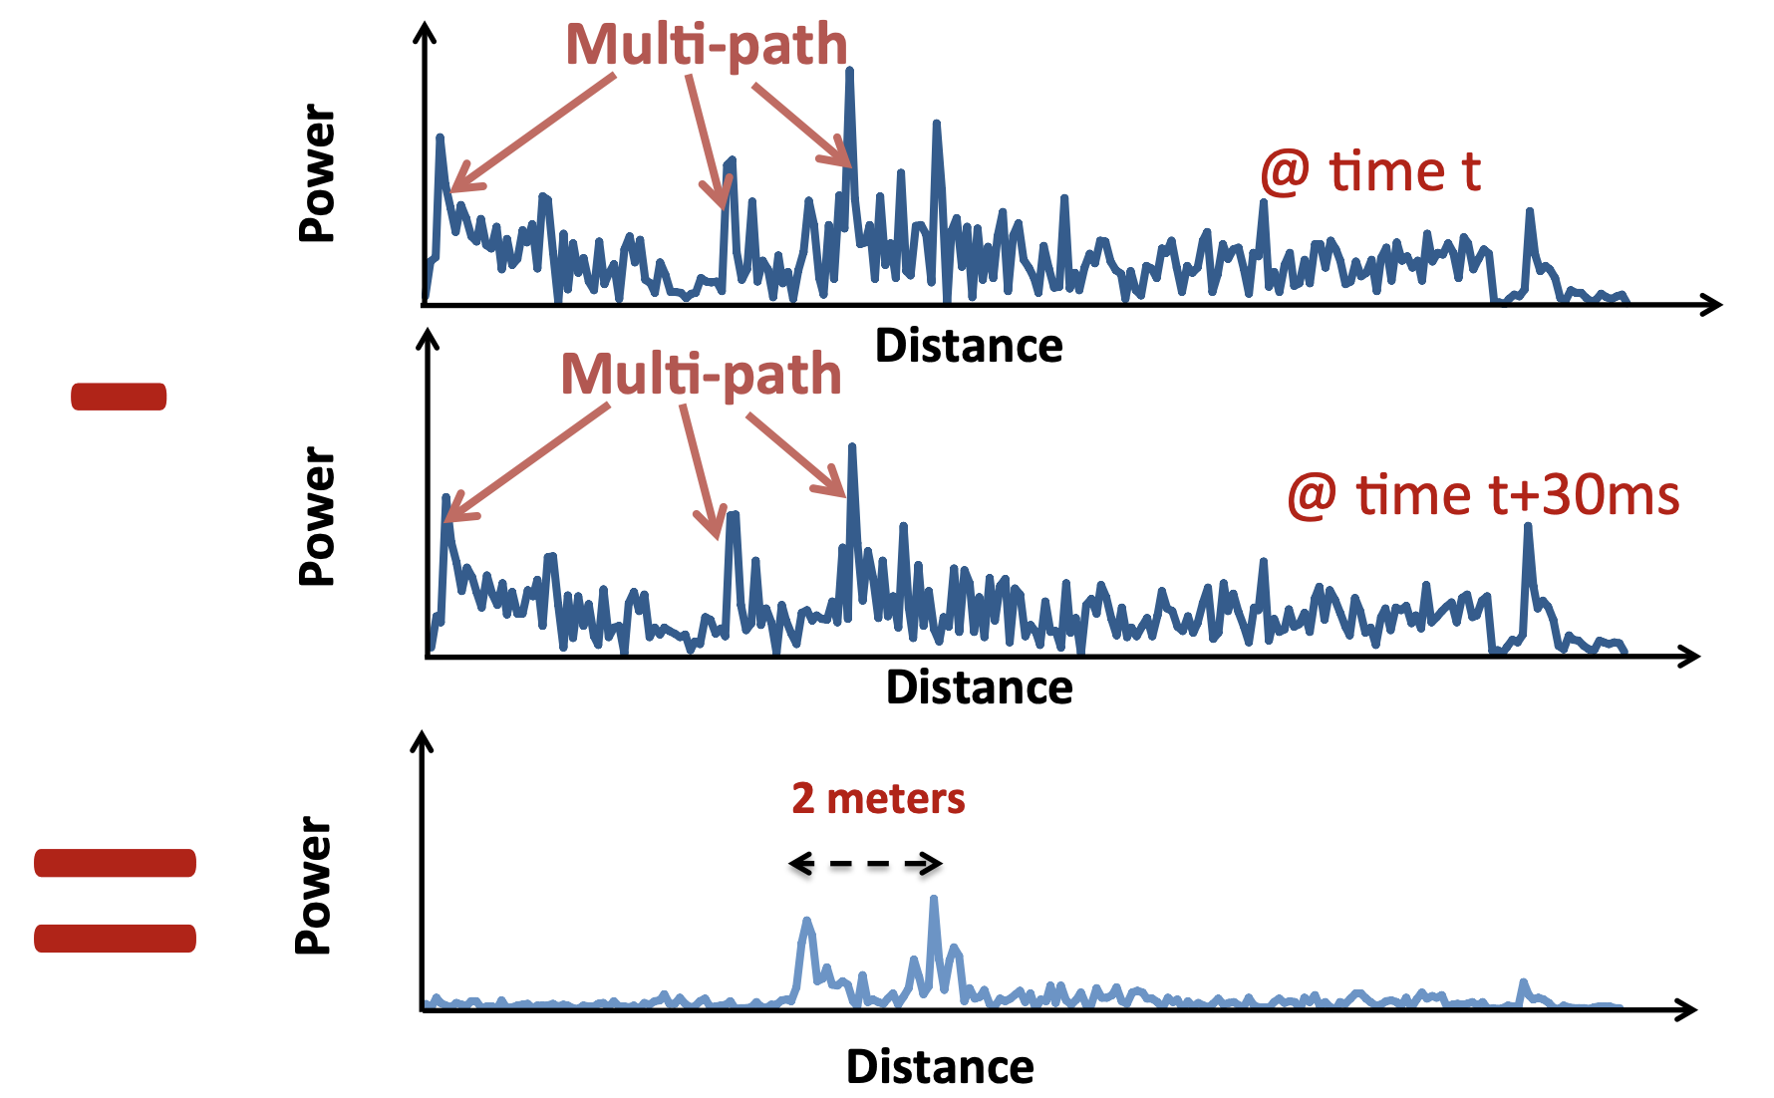
Handling Multipaths
Static objects do not move – have the peak at fixed positions
  Eliminate by subtracting consecutive measurements

Slide 61
Handling Multipaths
Static objects do not move – have the peak at fixed positions
  Eliminate by subtracting consecutive measurements
Why do we see two peaks, when we have only one moving person?

Slide 62
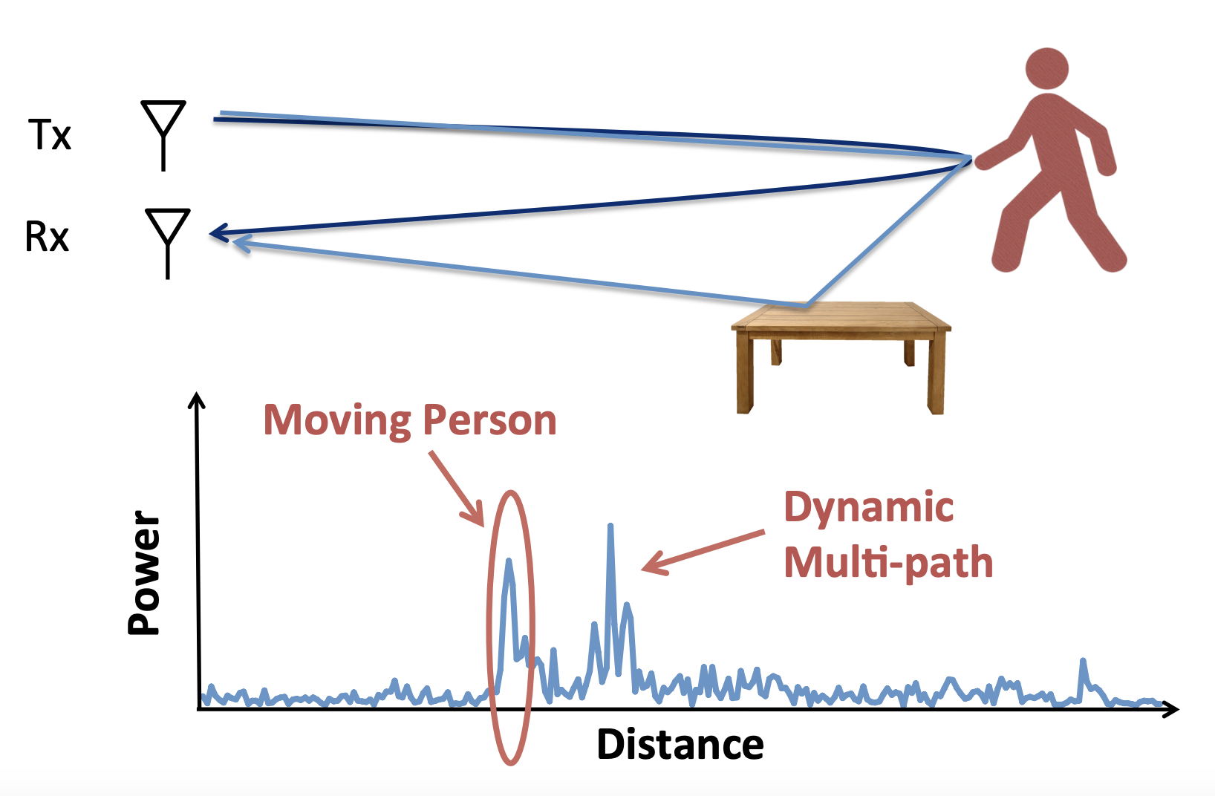
Dynamic Multipath
The reflected signal from the moving person may get reflected through another reflector

Slide 63
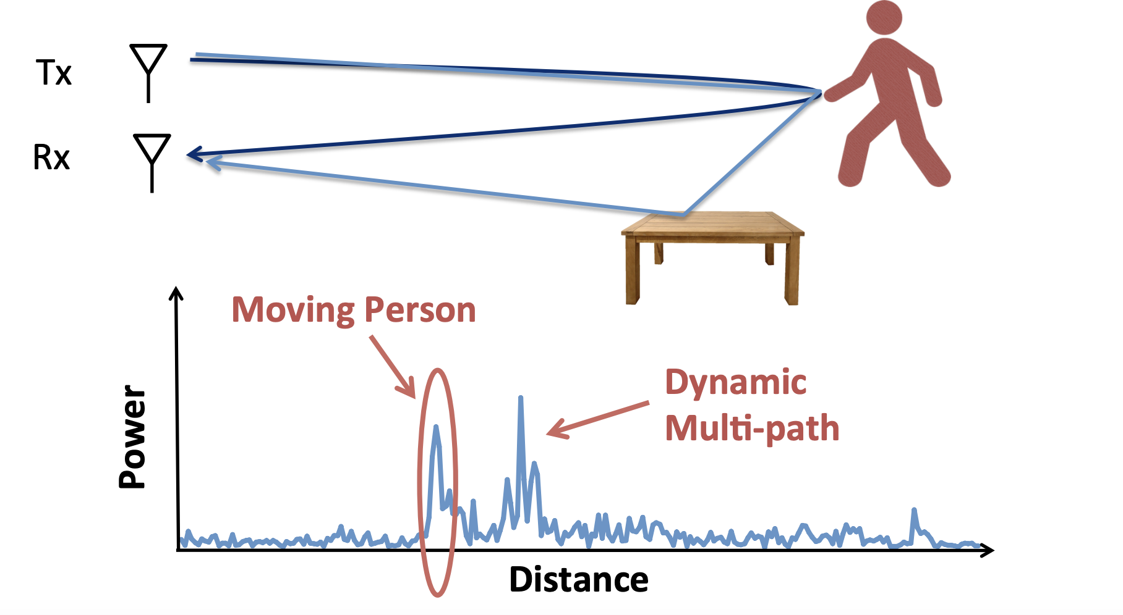
Handling Dynamic Multipath
The direct reflection arrives before the dynamic multipath

Slide 64
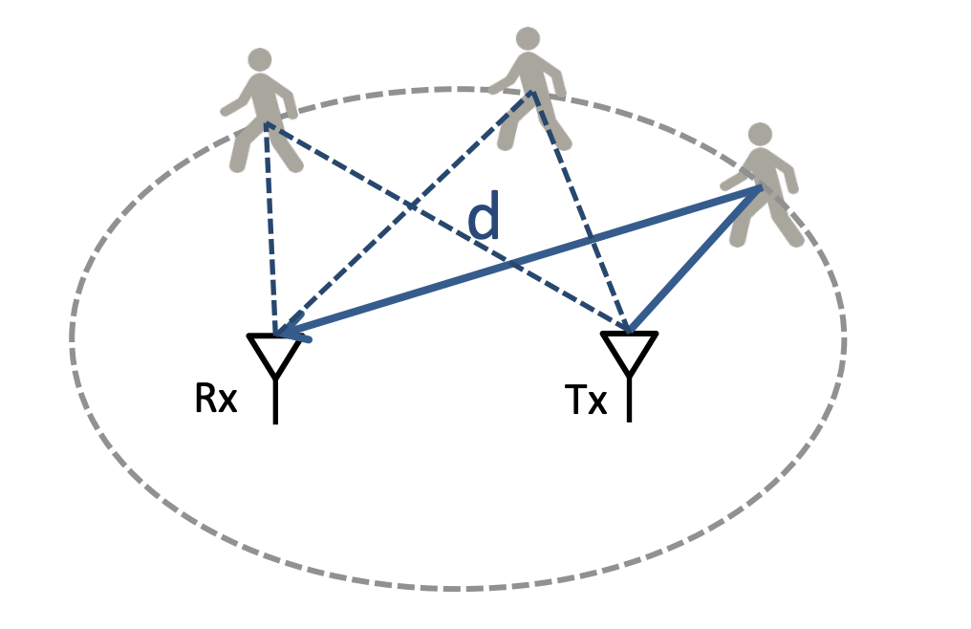
From Distance to Localization
Person can be anywhere in the ellipse whose foci are (Tx,Rx)
  One ellipse is not sufficient for localize

Slide 65
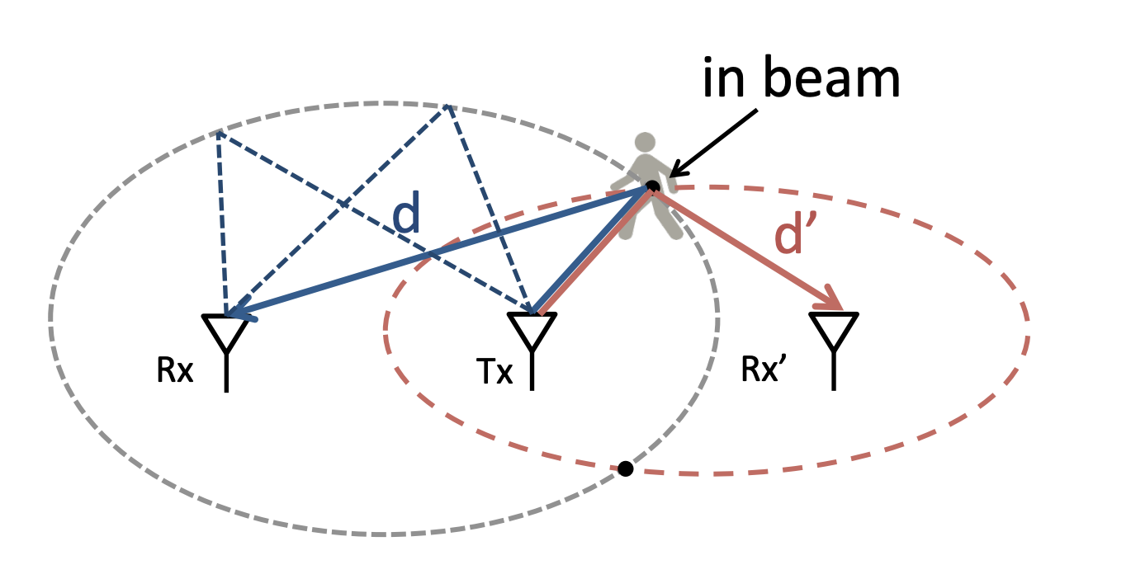
From Distance to Localization
Use multiple Rx to localize
  WiTrack uses directional antennas; so only one point is in-beam
  Use 3 Rx antennas for 3D localization

Slide 66
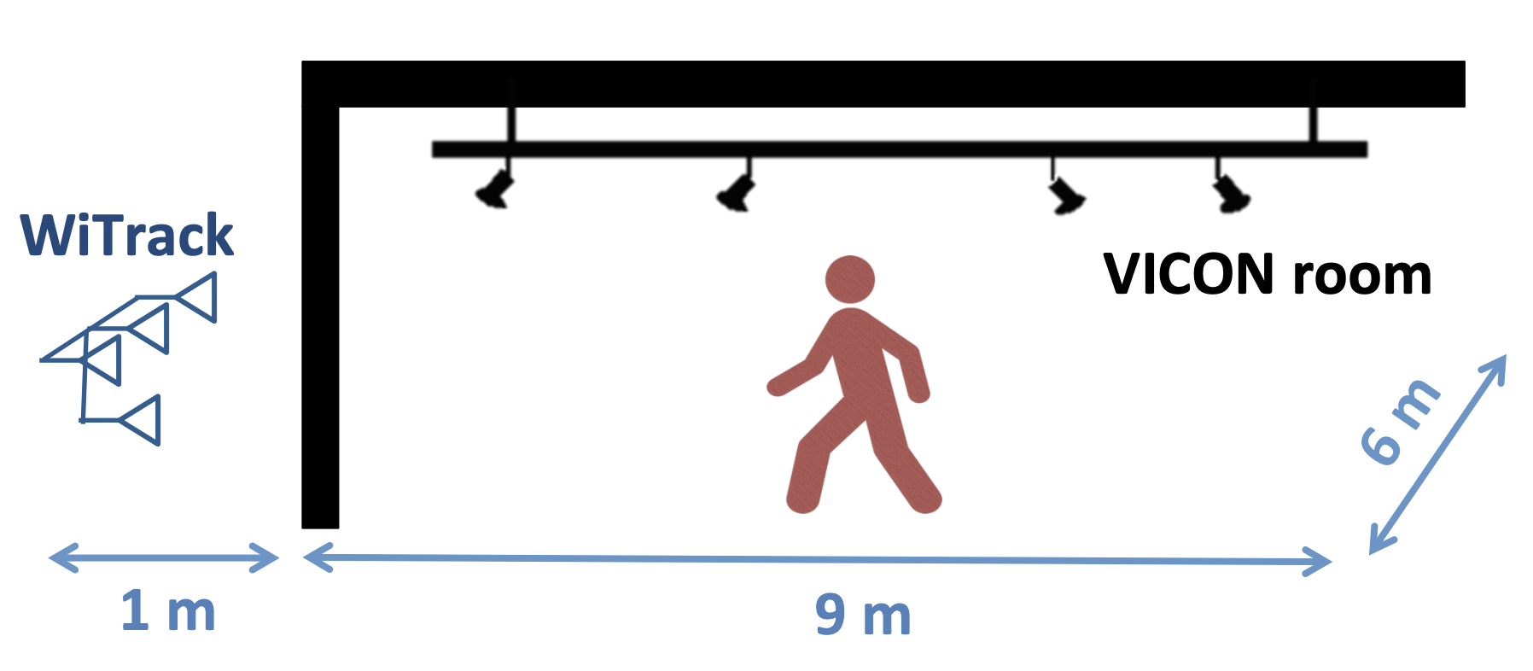
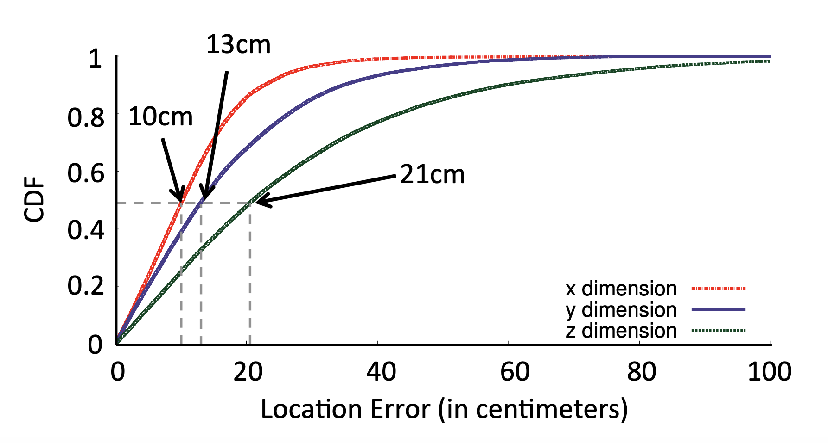
Performance

Slide 67
Performance
Centimeter-scale localization without requiring the user to carry a wireless device

Slide 68
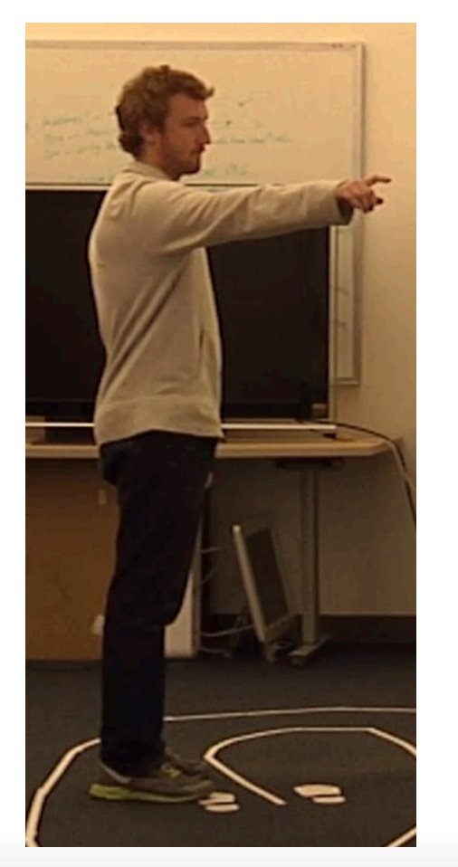
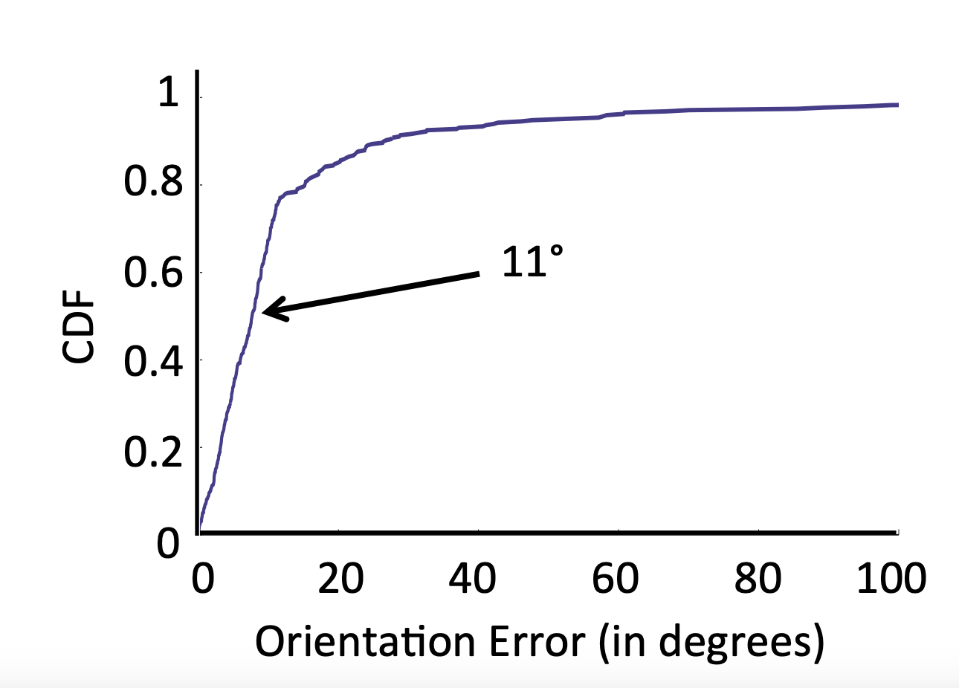
Performance
Person points in a random direction

Slide 69
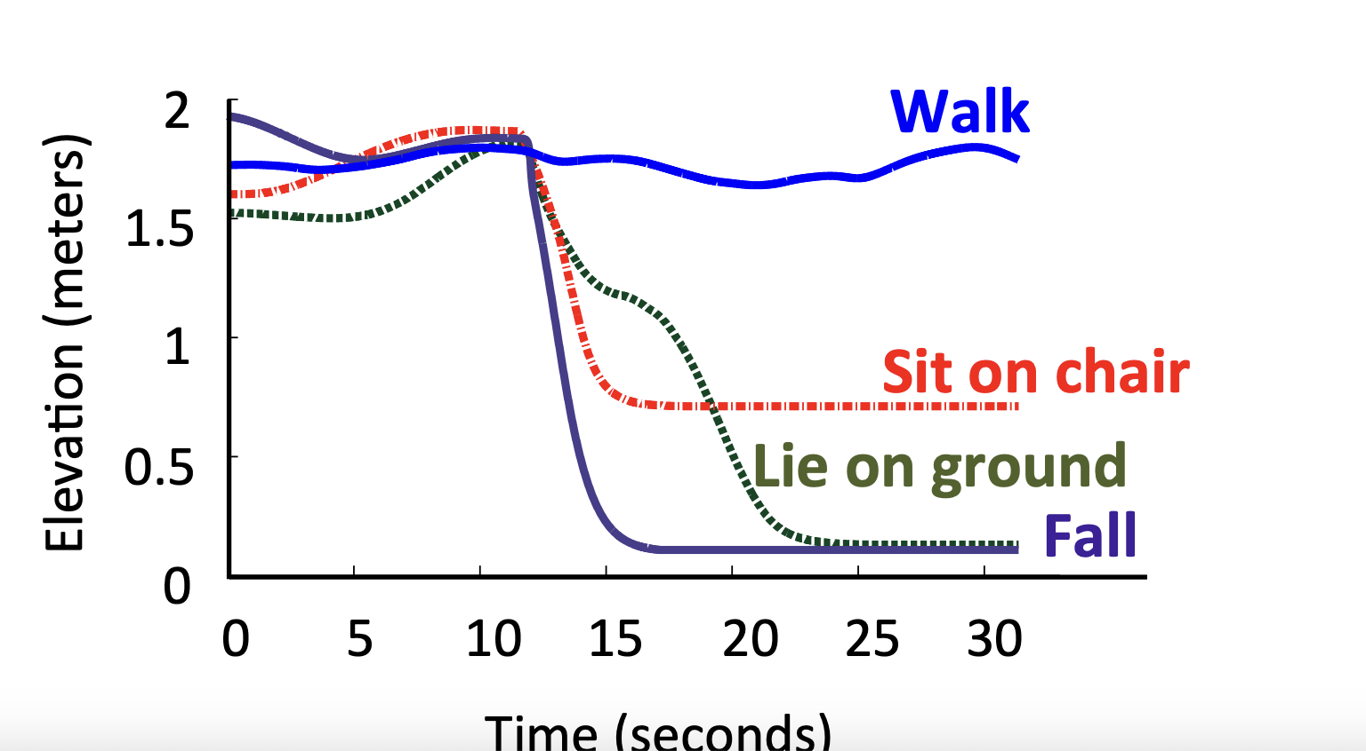
Performance
Elderly monitoring to detect fall
  Person simulates different activities

Slide 70
Summary
The wireless signal is capable of monitoring the user movement patterns without requiring the user to carry any additional devices
  Needs precise signal processing to estimate the reflection patterns
Limitations of WiTrack
  Can only detect a moving person
  Cannot concurrently track multiple peoples

Slide 71
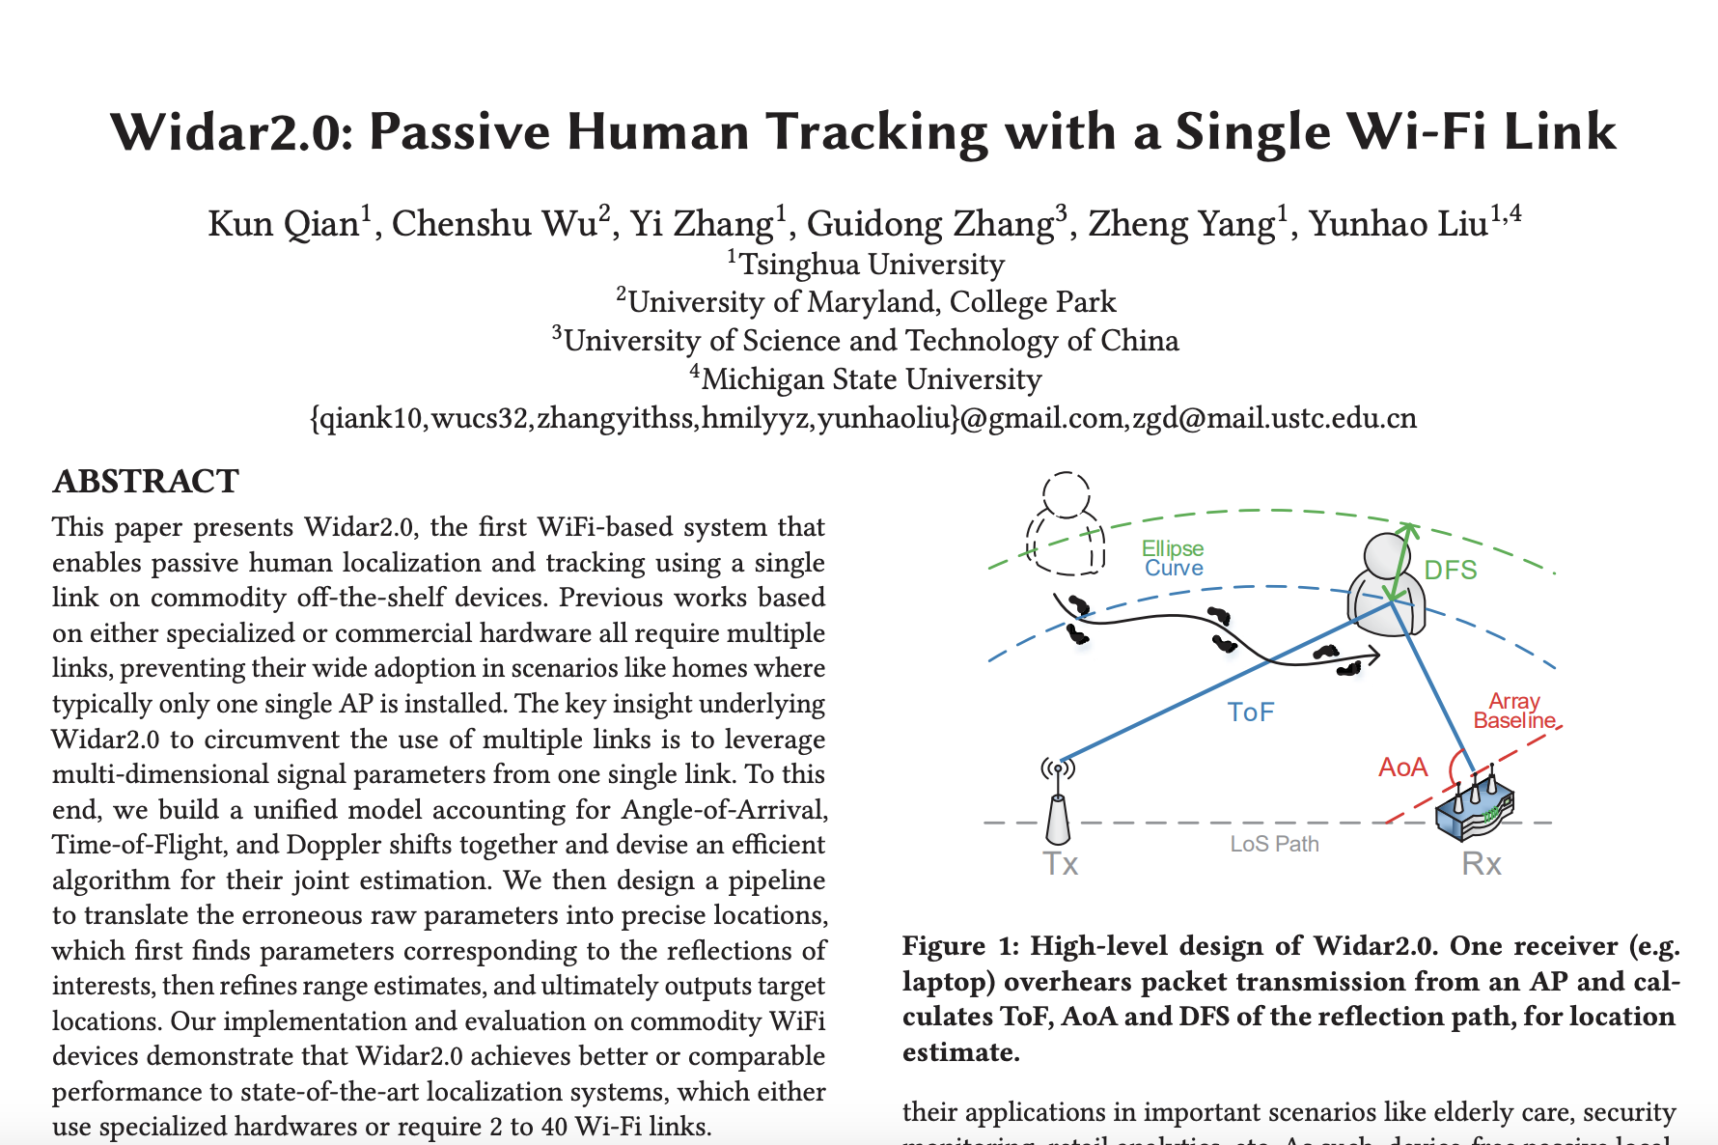

Passive Human Tracking with WiFi
ACM MobiSys 2018
Slides are based on the presentation by original authors

Slide 72
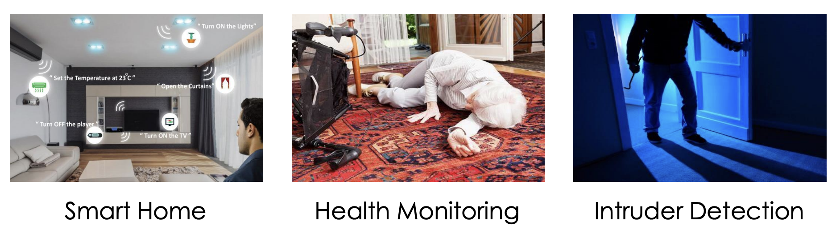
Motivation
Passive localization helps in various applications
RF vs Cameras
  Less privacy concerns
  Larger suveillance areas
  More ubiquitous deployment

Slide 73
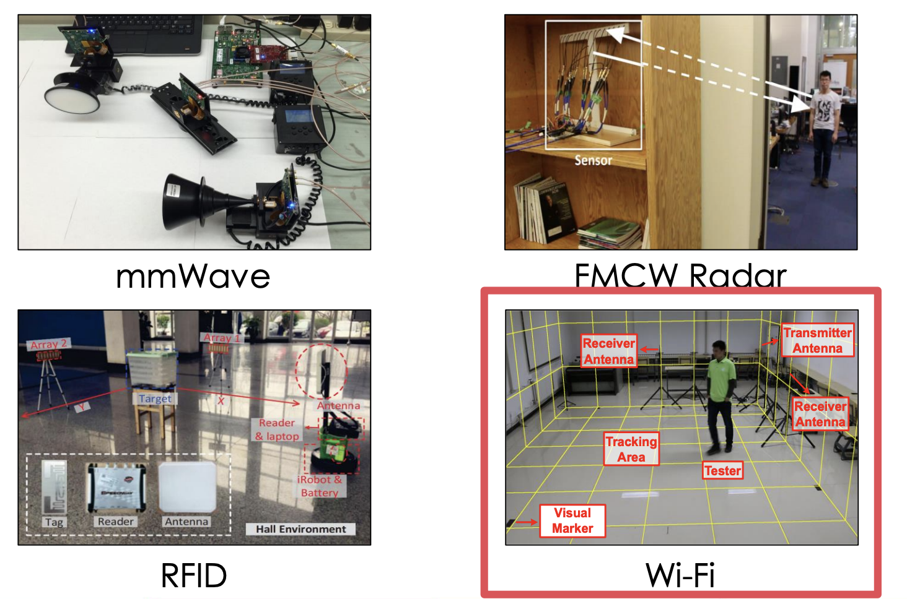
Motivation
RF-based tracking thrives with prevail RF devices

Slide 74
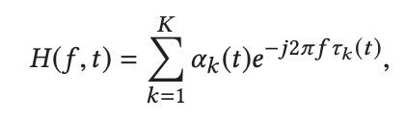
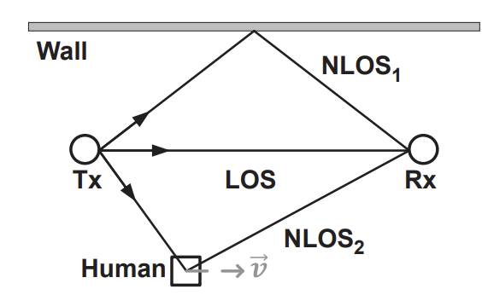
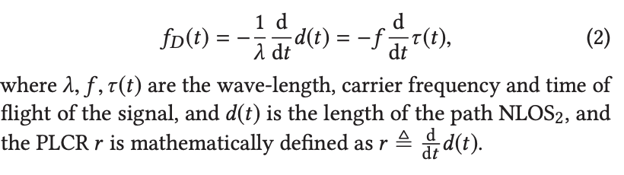
Widar: Exploring Doppler frequency shift for tracking
CSI:
Movement introduces Doppler effect: changes the frequency of the observed at the Rx
Frequency shift of the signal reflected from human body:

Slide 75
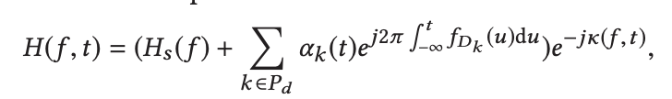
Widar: Exploring Doppler frequency shift for tracking
CSI:
Movement introduces Doppler effect: changes the frequency of the observed at the Rx
CSI can be represented as superimposition of path responses modulated by Doppler frequency shift arising from moving reflectors on each path:
Static Path
Dynamic Path

Slide 76
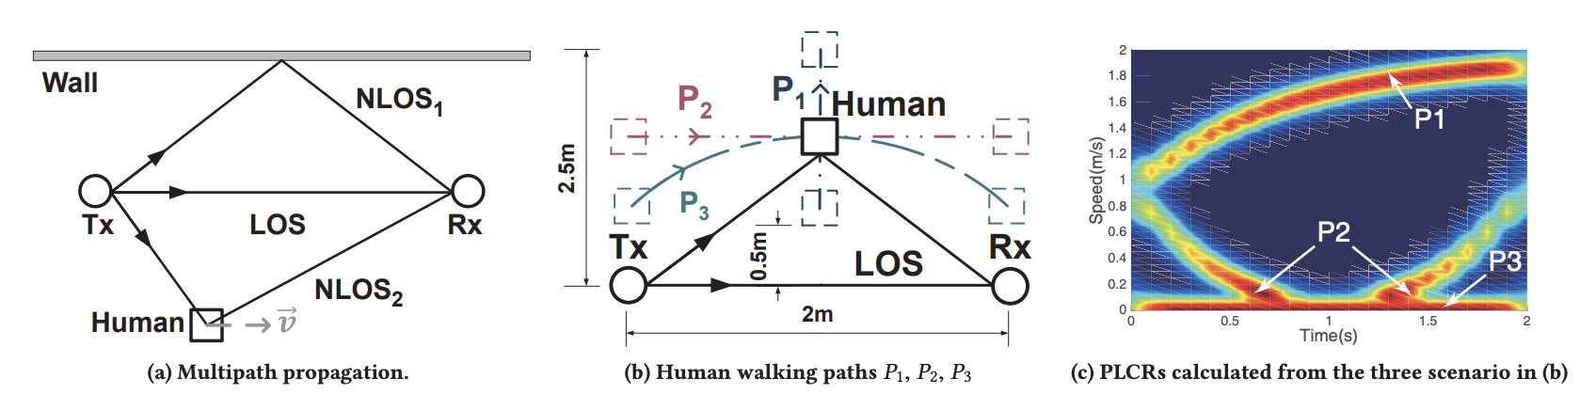

Widar: Exploring Doppler frequency shift for tracking
Explore Doppler frequency shifts (DFS) over multiple links to compute Path Length Change Rate (PLCR)

Slide 77
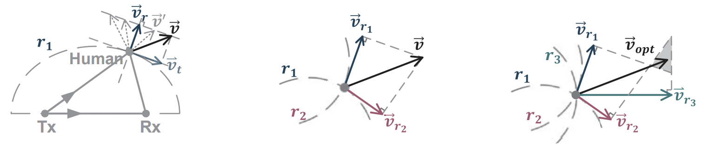
Widar: Exploring Doppler frequency shift for tracking
Multiple links give more precise path information
Three Links
One Link
Two Links

Slide 78
Widar: Exploring Doppler frequency shift for tracking
Explore Doppler frequency shifts (DFS) over multiple links to compute Path Length Change Rate (PLCR)
Widar requires
  DFS from multiple links to compute velocity
  Trial and error to reduce direction ambiguity
  Costly search to spot the initial location

Slide 79




Other Related Works in the Literature
Existing approaches need
  Single Link but specialized hardware: Less ubiquitous
  Commercial devices but multiple links: Less practical
Widar
Dynamic MUSIC
LiFS
WiTrack
WiDeo

Slide 80
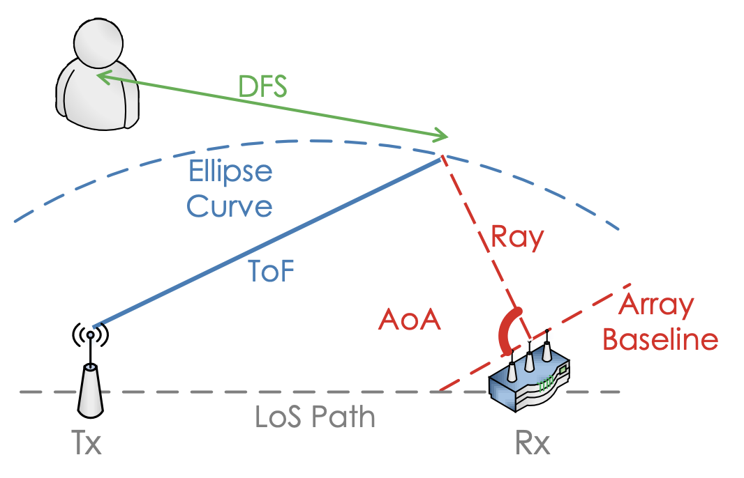
Key Idea
Can we achieve both ubiquity and practicality?
  Using a single commercial WiFi link
Track multiple signal parameters instead of just one, and then combine the information from all
  Angle of Arrival (AoA)
  Time of Flight (ToF)
  Doppler frequency shift (DFS)

Slide 81

Widar 2.0: Broad System Overview

Slide 82

CSI Model
As discussed, due to multipath effect, we can model CSI as
Wi-Fi NICs measure channel discretely in time (packet), frequency (subcarrier) and space (sensor)

Slide 83

CSI Model
As discussed, due to multipath effect, we can model CSI as
The delay of the 𝑙-^{th} path 𝜏_{𝑙} (𝑖,𝑗, 𝑘) is a combination of ToF 𝜏_{𝑙} , DFS 𝑓_{𝐷𝑙} and AoA 𝝓_{𝑙} = (cos𝜙_{𝑙} , sin𝜙_{𝑙} )^{T}

Slide 84

Parameter Estimation
Modeled as a maximal likelihood estimation (MLE)
L is the number of multipath
  L should be larger than the number of principal multipaths
  Widar 2.0 considers L=5

Slide 85


SAGE Algorithm
Space Alternating Generalized Expectation (SAGE) Maximization: A general version of EM algorithm
  Each iteration of the algorithm only re-estimates a subset of the components of Θ while keeping the estimations of the othercomponents fixed
Estimation step:
Maximization step:

Slide 86


CSI Cleaning
CSI contains not only channel response, but also various unknown phase noises (timing offset and carrier frequency offset)
Linear Regression calibration does not work (assumption: Phase noises are linear across subcarriers)
  Weak reflection from human body

Slide 87
CSI Cleaning
Code idea used in Widar 2.0
  CSI phase noises caused by TO and CFO only vary in time and frequency, but not space.
  All sensors of the same NIC experience the same unknown phase noises at the same time
Selects a sensor as the reference sensor (e.g. k₀-th sensor), calculate the conjugate multiplications C(m), between CSIs of each sensor and the reference sensor

Slide 88

CSI Cleaning
Use conjugate multiplication between each antenna and chosen reference antenna
By classifying multipath into static signals 𝑃_{𝑠} (𝑓_{𝐷} = 0) and dynamic signals 𝑃_{𝑑} (𝑓_{𝐷} ≠ 0) , we have

Slide 89
CSI Cleaning
Use conjugate multiplication between each antenna and chosen reference antenna
By classifying multipath into static signals 𝑃_{𝑠} (𝑓_{𝐷} = 0) and dynamic signals 𝑃_{𝑑} (𝑓_{𝐷} ≠ 0) , we have
Remove through high pass filter, as static signals are constant
Much weaker than the first two, as static signals are much stronger

Slide 90

CSI Cleaning
The target term preserves the CSI phase

Slide 91

Path Matching
Multipath parameters are cluttered together

Slide 92


Path Matching
Graph-based Path Matching (GPM)
  Model successive parameters as the weights of a N-partite graph for N CSI segments
  The joint estimate of the parameter values does not change significantly across successive CSI measurements, so the total path weight would be minimum
edge wight is modeled as the distance between parameters

Slide 93

Range Refinement
Range estimation with ToF or DFS
  ToF -> coarse estimate of absolute range
  DFS -> fine estimate of change rate of range
Use Kalman filter to refine range with both ToF and DFS

Slide 94


Experiment
Implementation
  Thinkpad laptops with Intel 5300 NIC
Setup
  3 scenarios: classroom, corridor, office
Tracking samples

Slide 95


Performance

Slide 96
Summary
Robust multi-parameter RF tracking
  Over a single link
  A unified model of ToF, AoA and DFS
  CSI calibration for weak reflection path
  Robust parameter matching and refinement for localization
Decimeter-level passive tracking system
  Median location error of 7.5dm with one single link

Slide 97




Happy Learning!
Some resources related to this topic

